Slide 1

Data Analysis

Slide 2
What is Data Analysis?
Data analysis is the process of cleaning, changing, and processing raw data to extract actionable, relevant information enhances informed decisions making.
It involves a systematic approach to understanding the underlying patterns, trends, and relationships within a dataset.

Slide 3
Why Data Analysis?
Better problem solving methods
Optimizing performances
Better customer targeting
Getting more accurate data

Slide 4
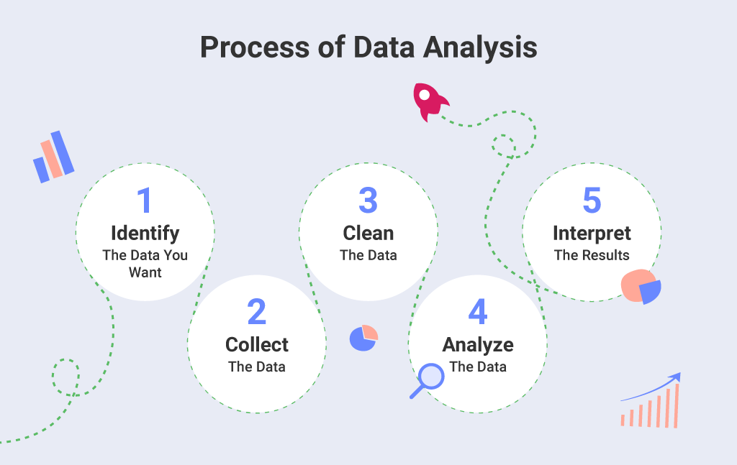
Data Analysis Process
[Source: https://www.slingshotapp.io/blog/types-of-data-analysis]

Slide 5
Data Analysis Process
Data Collection: Gathering relevant data from various sources, which can be structured (in databases, spreadsheets) or unstructured (text, images, videos).
Data Cleaning and Preprocessing: Cleaning involves identifying and handling errors, inconsistencies, missing values, and outliers in the dataset. Preprocessing involves transforming the data into a suitable format for analysis, which might involve normalization, scaling, or encoding categorical variables.
Exploratory Data Analysis (EDA): This step involves summarizing the main characteristics of the data through various statistical and visual techniques. EDA helps in identifying patterns, trends, and potential insights that guide further analysis.

Slide 6
Data Analysis Process
4.Hypothesis Testing: In some cases, analysts may have specific hypotheses they want to test. This involves using statistical methods to determine whether observed patterns in the data are statistically significant or occurred by chance.
5.Statistical Analysis: Utilizing a variety of statistical techniques to quantify relationships between variables, identify correlations, perform regression analysis, and draw meaningful conclusions from the data.
6.Visualization: Creating graphical representations of the data to make it easier to understand and interpret. Visualizations help in identifying trends, patterns, and outliers that might not be apparent from the raw data.

Slide 7
Data Analysis Process
7.Interpretation and Insight Generation: Drawing meaningful insights from the analysis results, interpreting their implications, and using these insights to inform decision-making or further investigation.
Reporting and Communication: Summarizing the analysis findings in a clear and understandable way, often using visualizations and non-technical language. This communication is important for sharing results with stakeholders who might not have a technical background.

Slide 8
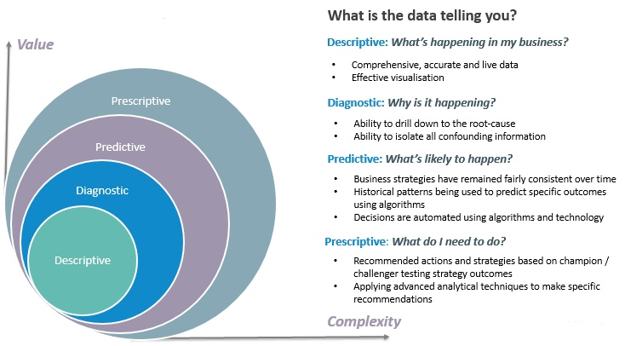
Types of Data Analysis
[Source: http://intomba.blogspot.com/2018/11/4-types-of-analytics.html]

Slide 9
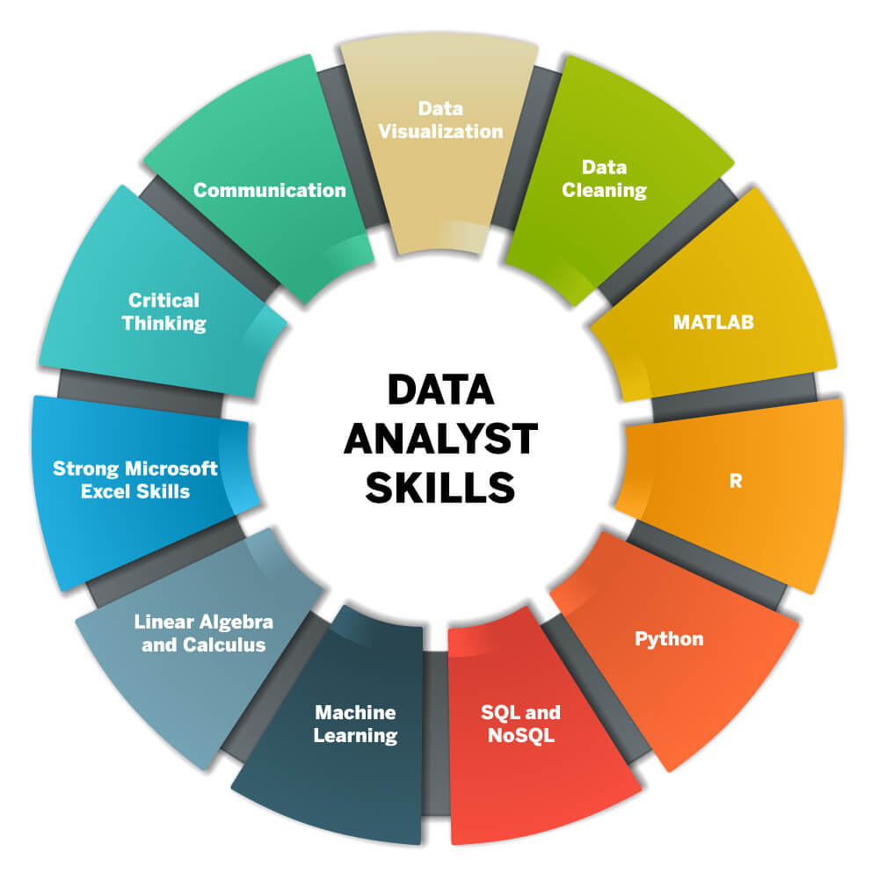
Skills Required for Data Analyst
[Source: https://bootcamp.cvn.columbia.edu/blog/data-analyst-skills/]

Slide 10


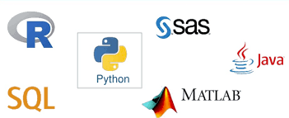


Tools Used in Data Analysis

Slide 11


Questions?

